Slide 1



COMPSCI 326
Lecture 02: Introduction to JavaScript

Slide 2

Agenda
JavaScript History
A brief tour of the history of JS
Java ≠ JavaScript
What are the similarities?
What are the differences?
Where to “run” JS
Browser
Node.js
JavaScript Fundamentals

Slide 3

JavaScript History: The Bad Parts
JavaScript has lots of bad parts.
In JavaScript, there is a beautiful, elegant, highly expressive language that is buried under a steaming pile of good intentions and blunders. - Douglas Crockford
JavaScript: The Good Parts (Crockford)
Wat

Slide 4
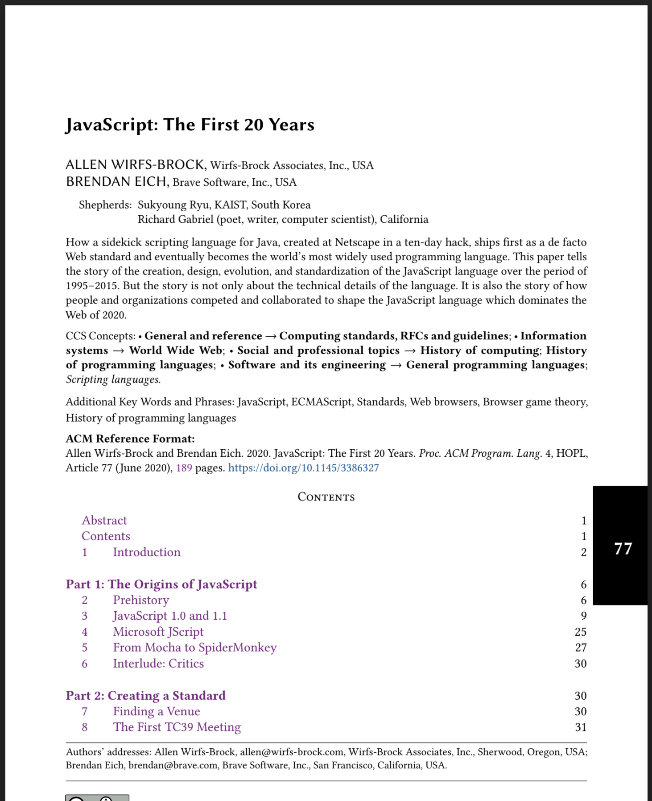
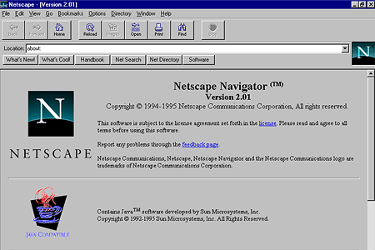
JavaScript History: Scripting the Browser
In 1995 Brendan Eich was recruited by Netscape to “come do Scheme in the browser”
Netscape was a popular early browser:
JavaScript: The First 20 Years, Allen Wirfs-Brock and Brendan Eich

Slide 5
JavaScript History: Scripting the Browser
The candidates for a web page scripting language included research languages such as Scheme as well as Unix-based languages such as Perl, Python, and Tcl, and Microsoft’s Visual Basic.
Although Brendan was expecting to implement Scheme in the browser, senior managers at Netscape and Sun (Marc Adreessen and Bill Joy) wanted him to build a language that complemented Java.
JavaScript: The First 20 Years, Allen Wirfs-Brock and Brendan Eich

Slide 6
JavaScript History: Scripting the Browser
This companion language to Java would have to look like Java while remaining easy to use and object-based rather than class-based, like Java.
The code-name “Mocha” was chosen for the browser scripting language by Marc Adreessen with the intent that it would eventually be renamed to JavaScript.
Brendan prototyped Mocha in 10 contiguous days in May, 1995.
JavaScript: The First 20 Years, Allen Wirfs-Brock and Brendan Eich

Slide 7
JavaScript History: Scripting the Browser
The prototype used a hand-written lexer and recursive-descent parser that emitted bytecode instructions. The bytecode interpreter was simple and slow.
The demo consisted of the bare minimum language implemented and minimally integrated into the Netscape 2 pre-alpha browser.
JavaScript: The First 20 Years, Allen Wirfs-Brock and Brendan Eich

Slide 8
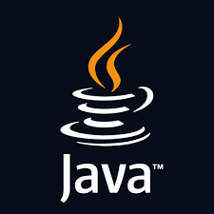
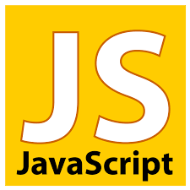
JavaScript History: Scripting the Browser
On December 4, 1995 in a joint release by Netscape and Sun announced JavaScript describing it as “an object scripting language” that would be used to write scripts that dynamically “modify the properties of and behavior of Java objects.”
It would serve as a “complement to Java for easy online application development.”
JavaScript: The First 20 Years, Allen Wirfs-Brock and Brendan Eich

Slide 9

JavaScript History: Scripting the Browser
The name similarity and its implication that the languages are closely related has been a continuing source of confusion.
JavaScript: The First 20 Years, Allen Wirfs-Brock and Brendan Eich

Slide 10

JavaScript History: Scripting the Browser
Netscape originally wanted to use JavaScript on the server in an environment called LiveWire that would dynamically generate web pages on the server. For a variety of circumstances this was a failure.
JavaScript eventually made its way onto the server (Node.js).
JavaScript: The First 20 Years, Allen Wirfs-Brock and Brendan Eich

Slide 11
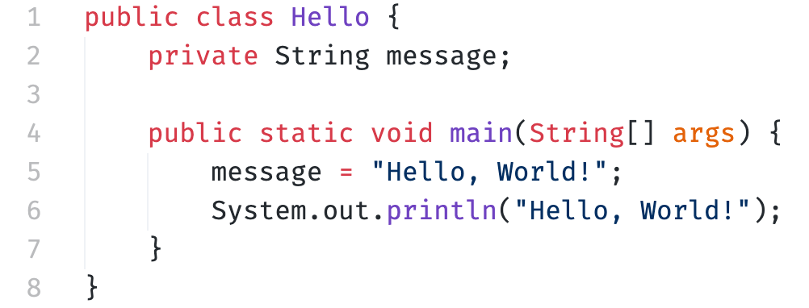
Java
Each statement ends in a semicolon
Has classes; create objects from classes
Static types
int i = 4; String s = “hello”;
i = s; // this is an error!
Lexically scoped (or blocked scoped) int x; { { int x; …. x …. } …. x …. }

Slide 12
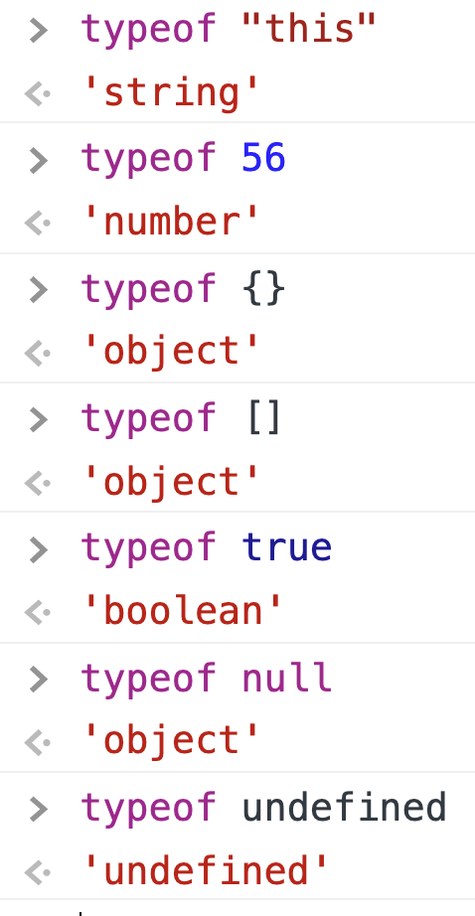
JavaScript: Data Types and Literals
JavaScript Data Types
string
number
object
boolean
undefined
JavaScript Literals
string: “hello”, ‘hello’
number: 56, 3.14, 0xFF
object: {}
object/array: []
boolean: true, false
object: null
undefined: undefined
JavaScript data types and data structures, MDN Web Docs

Slide 13
JavaScript: Variable Declarations
Variable Declarations
const
let
var
none of the above (do not do this!)
JavaScript Literals
string: “hello”, ‘hello’
number: 56, 3.14, 0xFF
object: {}
object/array: []
boolean: true, false
object: null
undefined: undefined
Grammar and types / Literals, MDN Web Docs

Slide 14

JavaScript Overview
console.log
console.assert
== vs ===
boolean: true/false
string, string.length, comparison
array, create, insert, indexing
object, create, insert, indexing, dot operator
const, let, var
functions, scope, parameters, return, calls
branching
looping
JavaScript, Mozilla Developer Network (MDN) This is an excellent resource for learning and exploring the JavaScript language and other web technologies.
let
JavaScript data types and data structures
Object
Array
Functions
Let’s bring up VSCode and start playing with some JavaScript!

